Slide 1

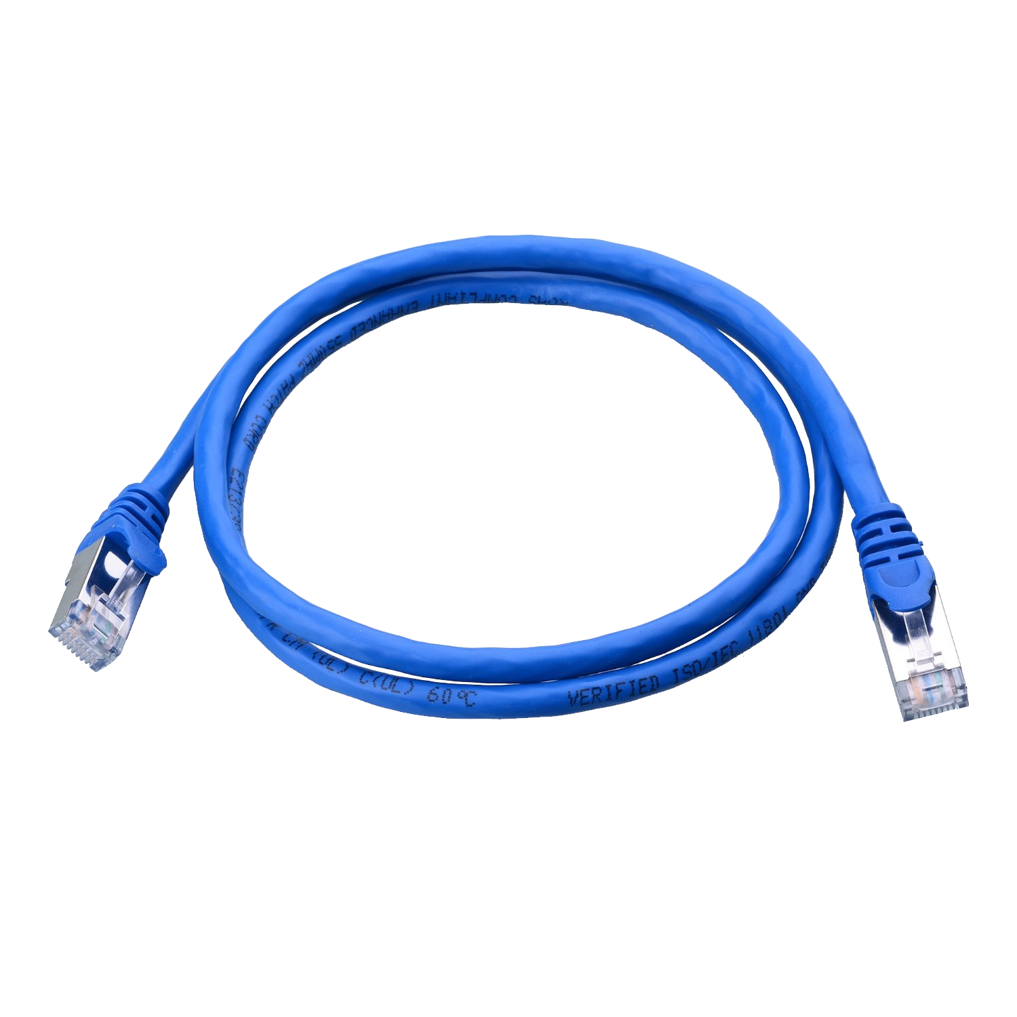
Cyber Defense Organization
Spring 2019 - Networking, A Functional Focus
PLEASE SIGN IN >>>>
https://bit.ly/2I0fCRM

Slide 2
Updates!

Slide 3

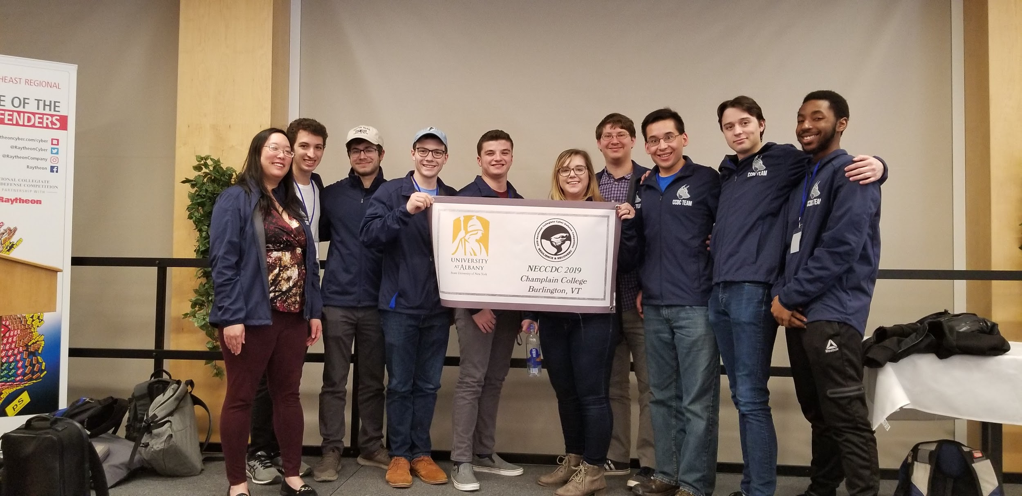
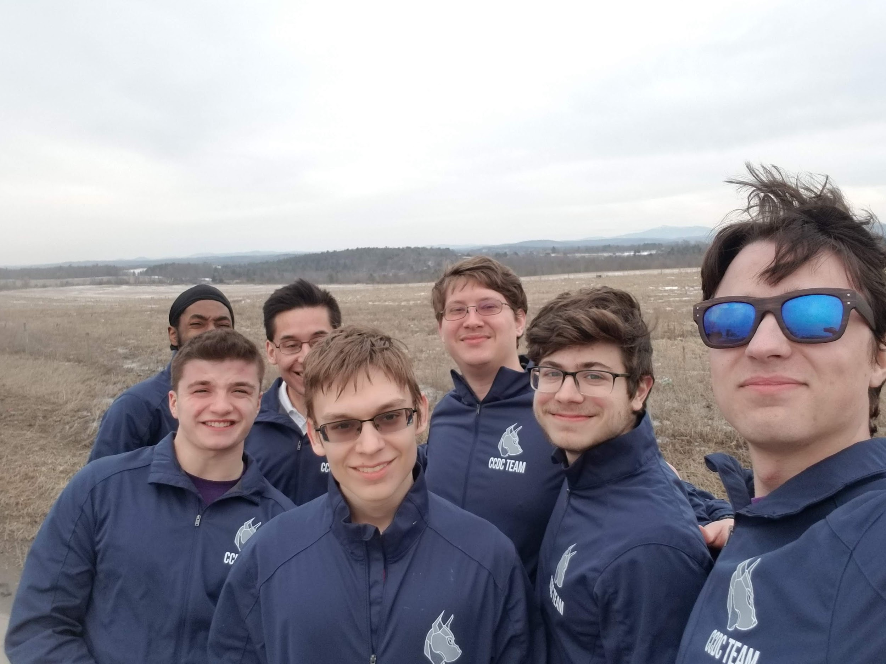
NECCDC Updates!

Slide 4
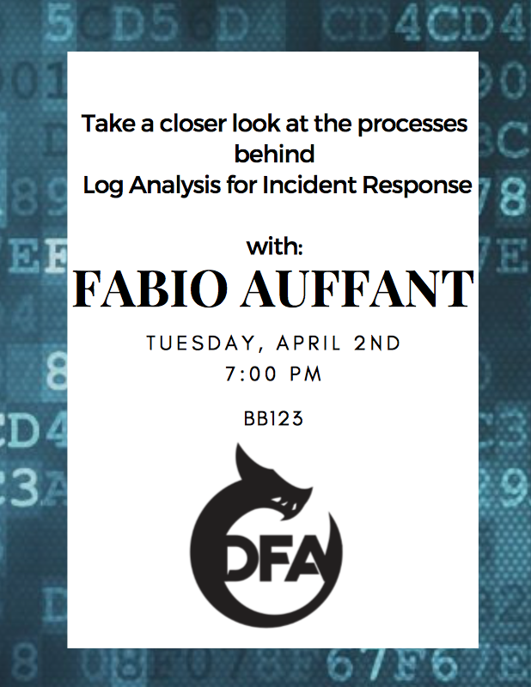
Other Events!
April 11th General Keith Alexander
April 12-13th NYC Women In Computing
April 12th Pentesting workshop - Training hours
April 17th Makerspace Open House

Slide 5

Other Events!

Slide 6
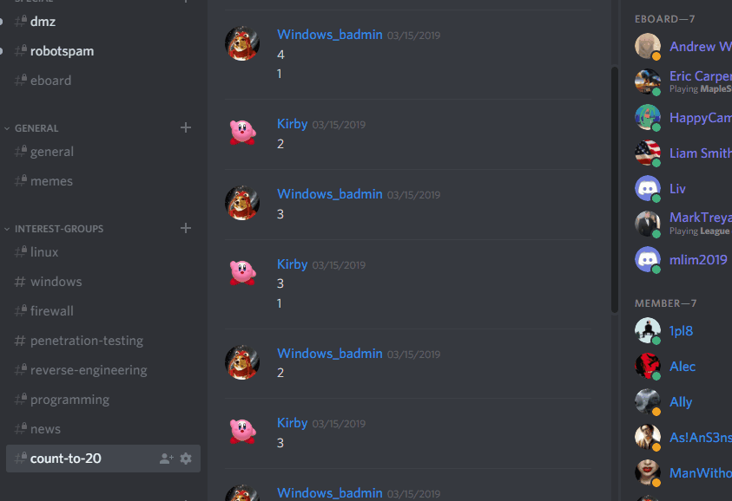
Discord Shenanigans

Slide 7

Upcoming Competitions
Central New York Hackathon
Beginner
25 People Registered! … out of 100 total
DATES: Friday, April 5th, 4p to 9p
Saturday, April 6th, 9a to 5p

Slide 8

Upcoming Competitions
Two teams
12 people total
University at Buffalo Lockdown v7
Defensive cyber security competition
Red vs Blue format
Beginner to intermediate skill level
April 27, 2019

Slide 9
Workshop!

Slide 10

Table of Contents
Basics
OSI Model Understanding
Network Devices
Important Network Protocols
Network Errors

Slide 11

Basics (Question)
What does a computer need on the network?
Answers
IP Address
MAC Address
Subnet Mask
Default Gateway

Slide 12

Basics (Abbreviations)
Damn IT!
LAN (Local Area Network)
Where you are sitting now
WAN (Wide Area Network)
Internet

Slide 13
Basics (Cont.)
IP Address
Address of the Computer within its network
“Home Address”
Ex: 192.168.1.124
Subnet Mask
Defines what network you are apart of
“Zip Code”
Ex: 255.255.255.0
MAC Address
Physical address of the device
Given when created in factory
“Social Security Number”
Ex: 00-14-22-01-23-45
Default Gateway
Exit point of the network, Connection to the internet
“Post Office”
Ex: 192.168.1.1

Slide 14
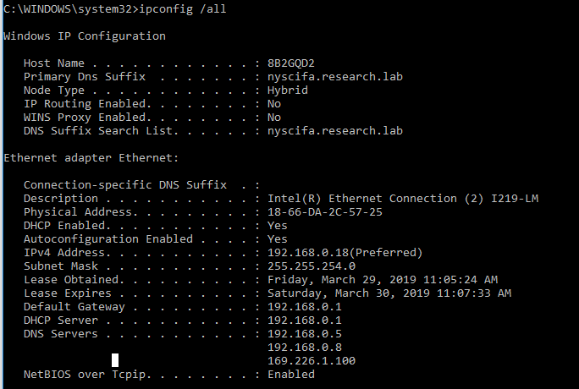
Windows Example
Where are:
IP Address?
Subnet Mask?
MAC Address?
Gateway?

Slide 15

Lets Go to Packet Tracer!
https://tinyurl.com/2019NetworkingCDOWorkshop
Notes:
Move through having them set up a small network using the the basics taught. Then have them ping the other computer from there and reach the outside network. Build Checklist for them to use for this. Keep them on packet tracer when done.

Slide 16

Important Info for Hands on
HeadQuarters
Default Gateway: 192.168.1.1
Subnet Mask: 255.255.255.0
DNS Server: 192.168.1.100
Remote Office
Default Gateway: 172.16.3.1
Subnet Mask: 255.255.255.0
DNS Server: 192.168.1.100
Notes:
Explain Dynamically assigning them and statically assigning them after they complete this.

Slide 17
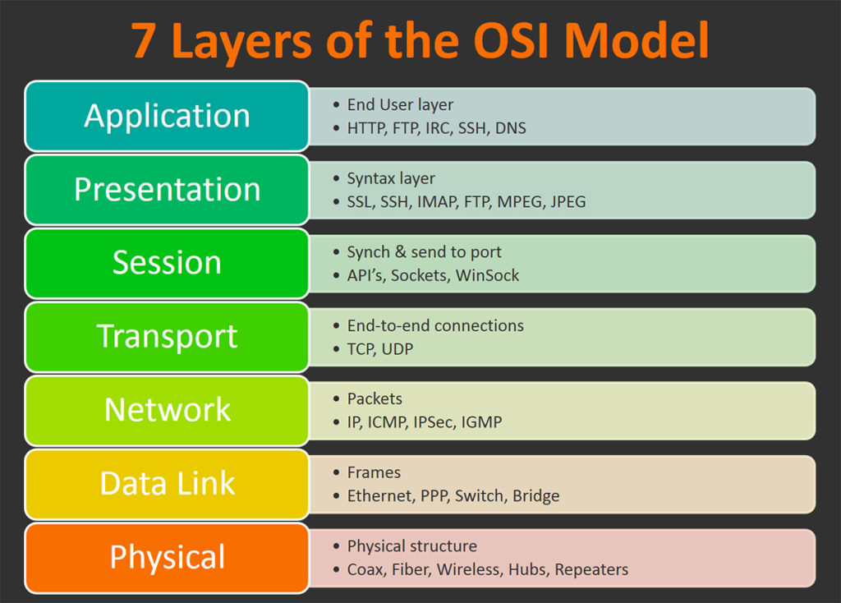
OSI Model & Packets
Encapsulation
Notes:
Mainly Speak About Layers 1 through 5
Physical - Cable
Data link - LAN Communication and MAC Address
Network - WAN Communication and IP Address
Transport - Setting up Communication Channel
Session - Stating what data will be transferred Port

Slide 18
Network Devices
Switch
Layer 2 device
Uses Destination MAC Address of the Packet Sent
Uses a MAC table
Maps the MAC Address of the computer to the port it is connected on
Hubs
Layer 1 Device
Takes the packet sent, Shoves out all ports except the one sent on
Routers
Layer 3 Device
Holds Default Gateway
Uses Destination IP Address
Uses Routing table to route the Packets to their needed destination
Endpoint devices
Servers
Tend to serve data for users
Examples
Computers
Device that you are using

Slide 19
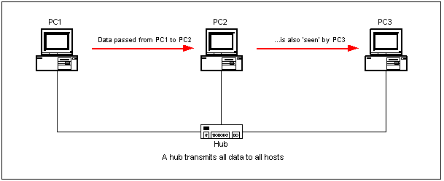
Hub
Layer 1 Device
Takes the packet sent, Shoves out all ports except the one sent on

Slide 20
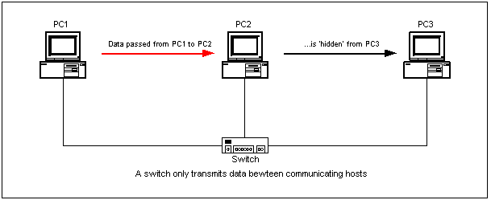
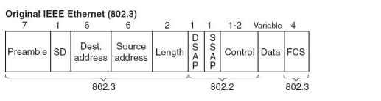
Switch
Layer 2 device
Uses Destination MAC Address of the Packet Sent
Uses a MAC table
Maps the MAC Address of the computer to the port it is connected on

Slide 21
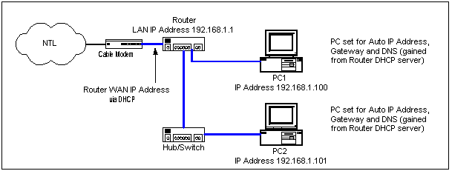
Router
Routers
Layer 3 Device
Holds Default Gateway
Uses Destination IP Address
Uses Routing table to route the Packets to their needed destination

Slide 22
Important Network Protocols
User Datagram Protocol (UDP)
Sends the data and forgets it
Relies on other sources to fix data loss
Transport Control Protocol (TCP)
Establishes a channel for communication
Has established rules
Three way Handshake
Address Resolution Protocol (ARP)
Resolves IP Address to MAC Address
Allows Communication to other Devices
Domain Name Service (DNS)
Resolves URLs to IP Address
Allows for using “www.google.com“

Slide 23
Back to Packet Tracer!
Notes:
Go to the More Complex Environment. Based off firewall workshop but not firewall and put a hub there.
Show Pings across the network. Point out:
ARP
DNS
Point out the network devices:
Switch
Router
Hub
Endpoints

Slide 24
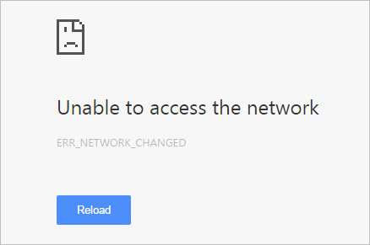
Dealing with Network Errors
How do you usually find them?
They are reported by co-workers/teammates
Troubleshooting Process
Ping, Traceroute gather info
Go Back to the basics
Move slowly up to more complex Issues

Slide 25
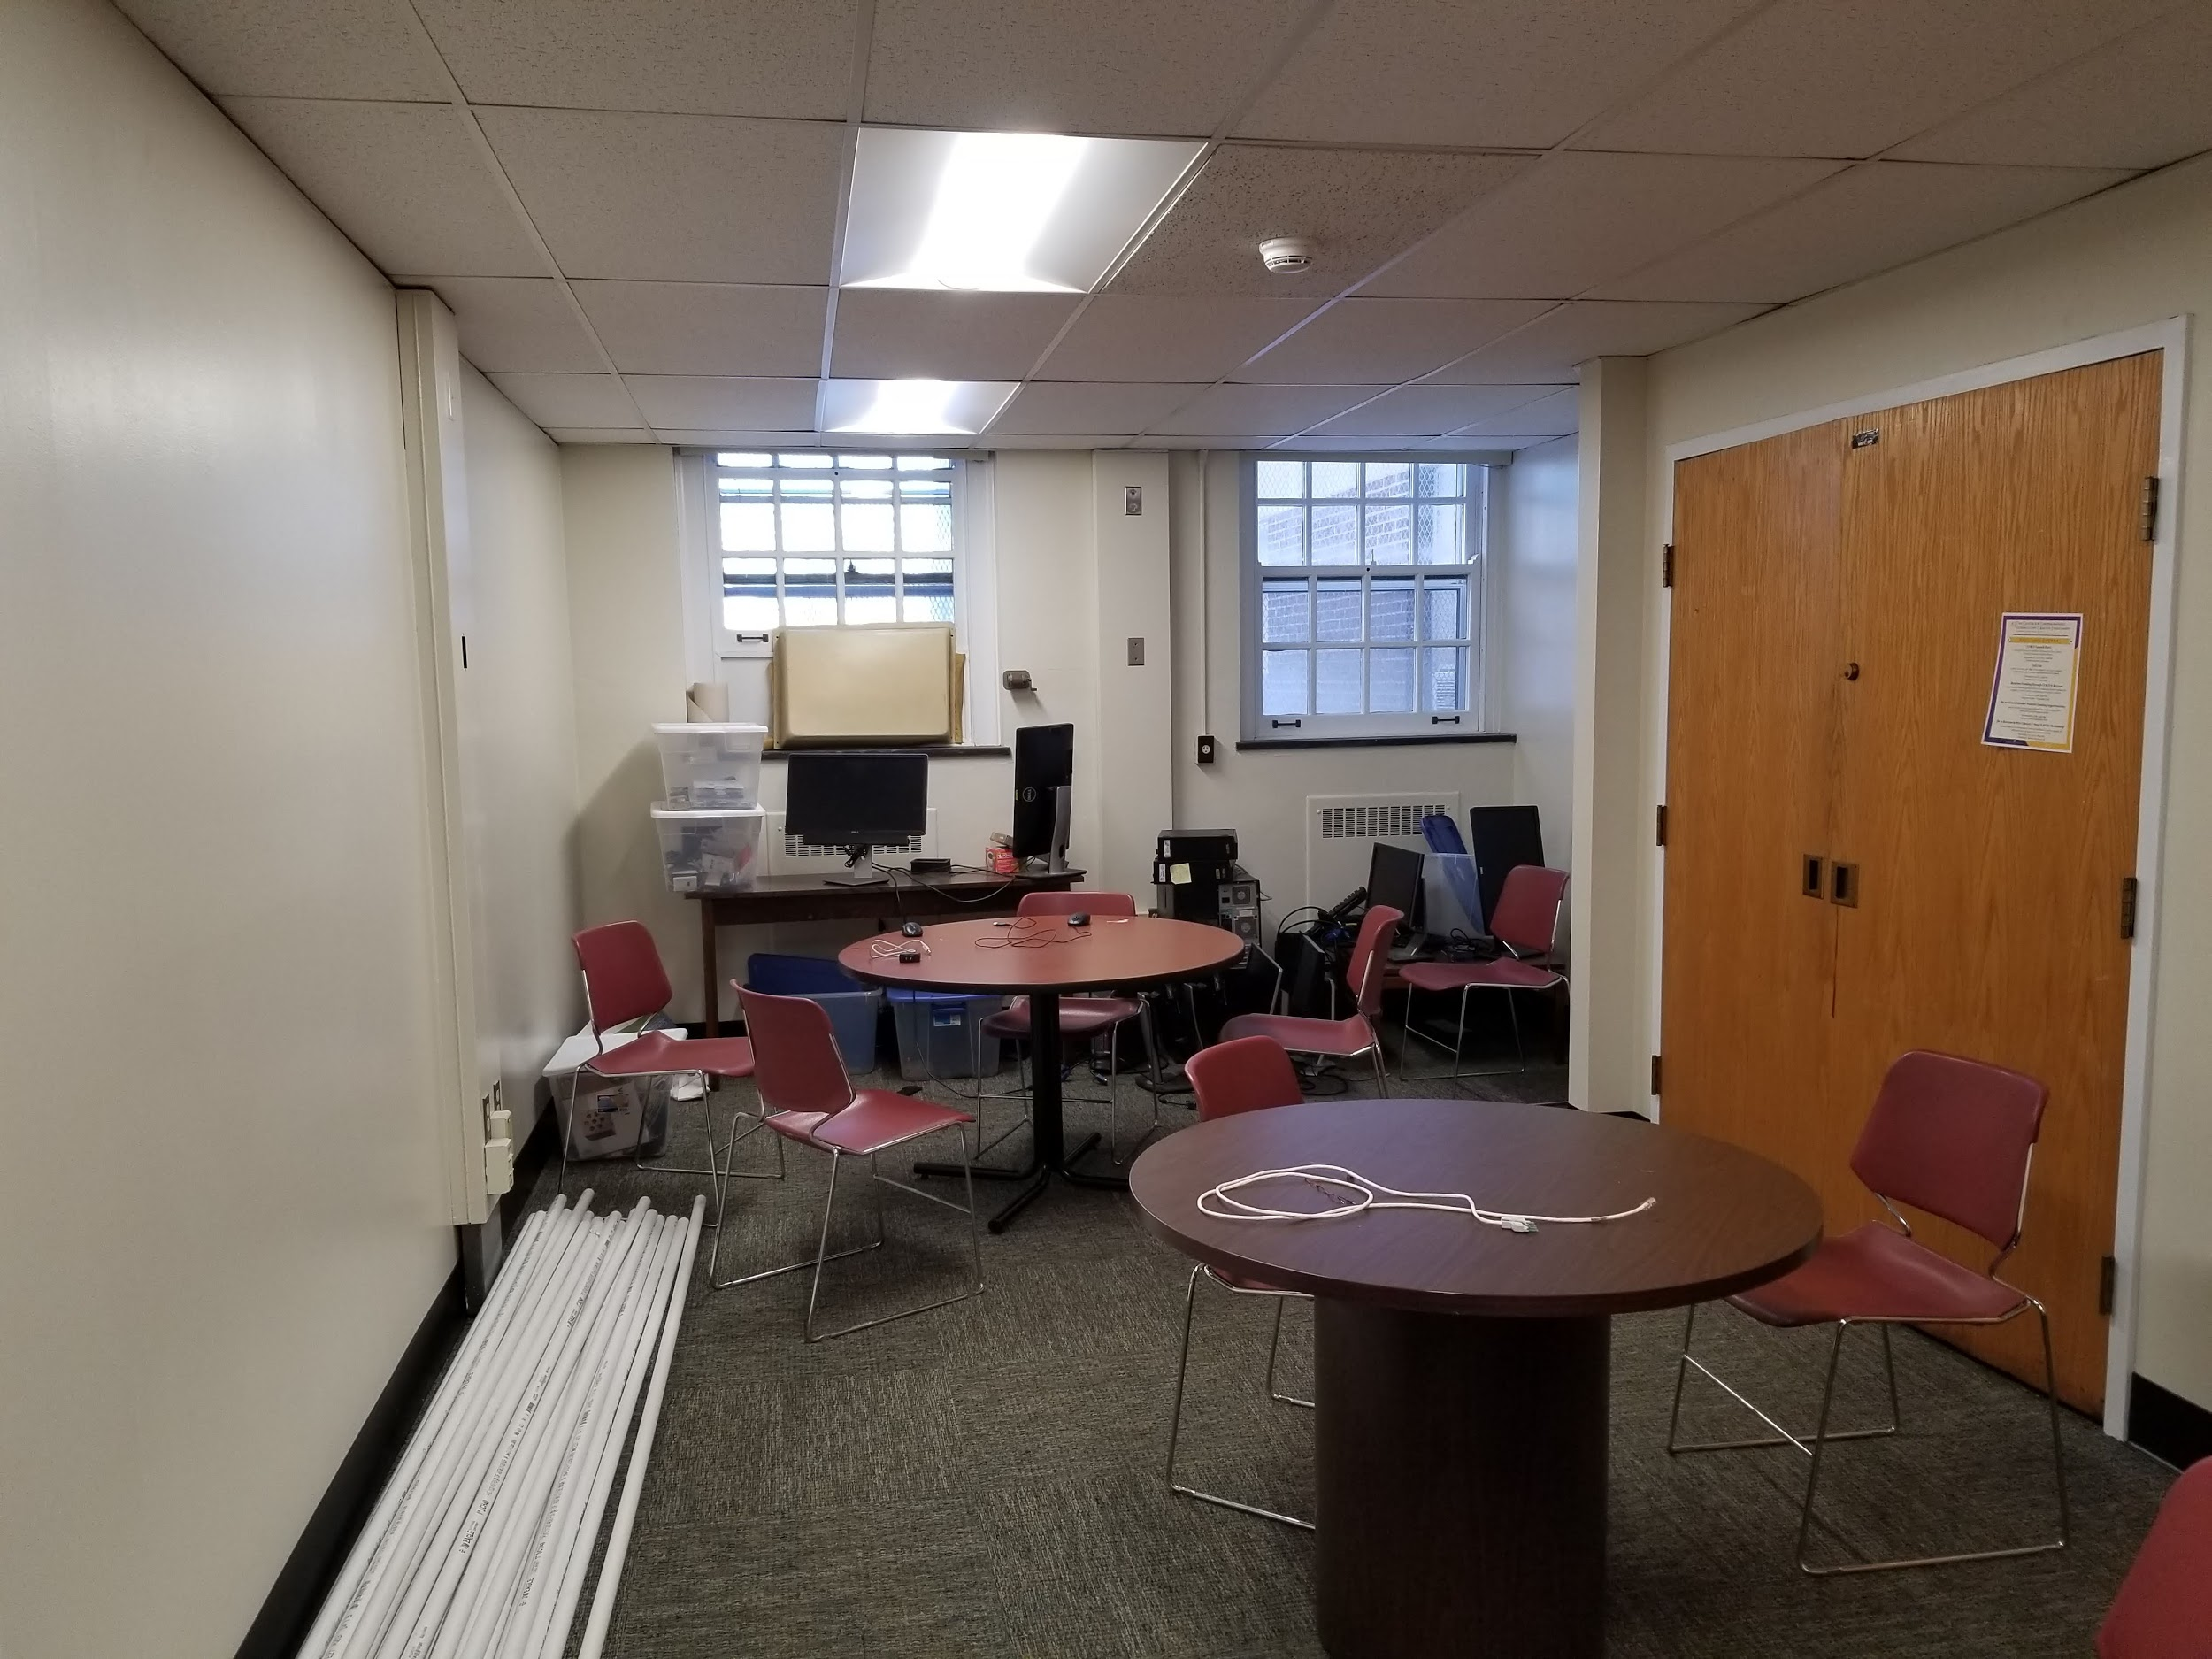

Major CDO Update! (Teaser =)

Slide 26




Cya Next week!
Log Analysis - April 2nd.
If you have any good memes send them to the email below.
wcsmith@albany.edu
Follow us on Twitter? Add on myInvolvement?
Talk to Liam or Eric to Pay for the TShirt!
https://discord.gg/9Dh6R5R

